Slide 1

RF-DETR: Real-Time Detection Transformers
Neural Architecture Search for Efficient Object Detection
Isaac Robinson et al., 2025

Slide 2







The Real-Time Detection Dilemma
CNN Legacy (YOLO)
DETR Transformers
The Challenge
Highly efficient for real-time edge deployment. However, limited global context modeling due to local receptive fields of convolutions.
Superior global reasoning and end-to-end detection. Historically too slow for real-time applications until the advent of RT-DETR and RF-DETR.
Finding the optimal balance between Mean Average Precision and Latency across diverse hardware and datasets.

Slide 3
Specialist Detection Transformers
Robinson et al. (2025) introduced RF-DETR to address the gap in lightweight transformer architectures.
•
Method: Weight-sharing Neural Architecture Search (NAS).
•
Performance: First real-time detector to exceed 60 AP on COCO.
•
Backbone: Built on high-performance DINOv2 Vision Transformers.
•
Adaptability: Thousands of sub-network configurations discovered without re-training.

Slide 4

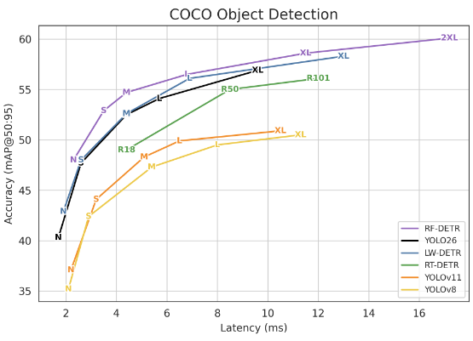
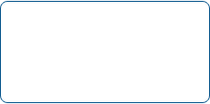

Innovation: Weight-Sharing NAS
Tunable Architecture Knobs
RF-DETR exposes a set of "knobs" that can be adjusted to find Pareto-optimal points:
•
Input Resolution: 320 to 960 pixels.
•
Patch Size: 8, 10, 12, 14, 16, etc.
•
Decoder Layers: 0 to 6 blocks.
•
Query Tokens: 50 to 300 queries.
•
Attention: Windowed vs. Global modes.
Primary Metric: mAP@50:95

Slide 5



RF-DETR Model Lineup
Nano / Small
Medium / Large
XL / 2XLarge
Optimized for NVIDIA Jetson and edge devices. High speed, minimal footprint.
The standard balance for server-side real-time processing on T4/L4 GPUs.
State-of-the-art accuracy, outperforming GroundingDINO while remaining real-time.
48.4 - 53.0 AP
54.7 - 56.5 AP
58.6 - 60.1 AP

Slide 6
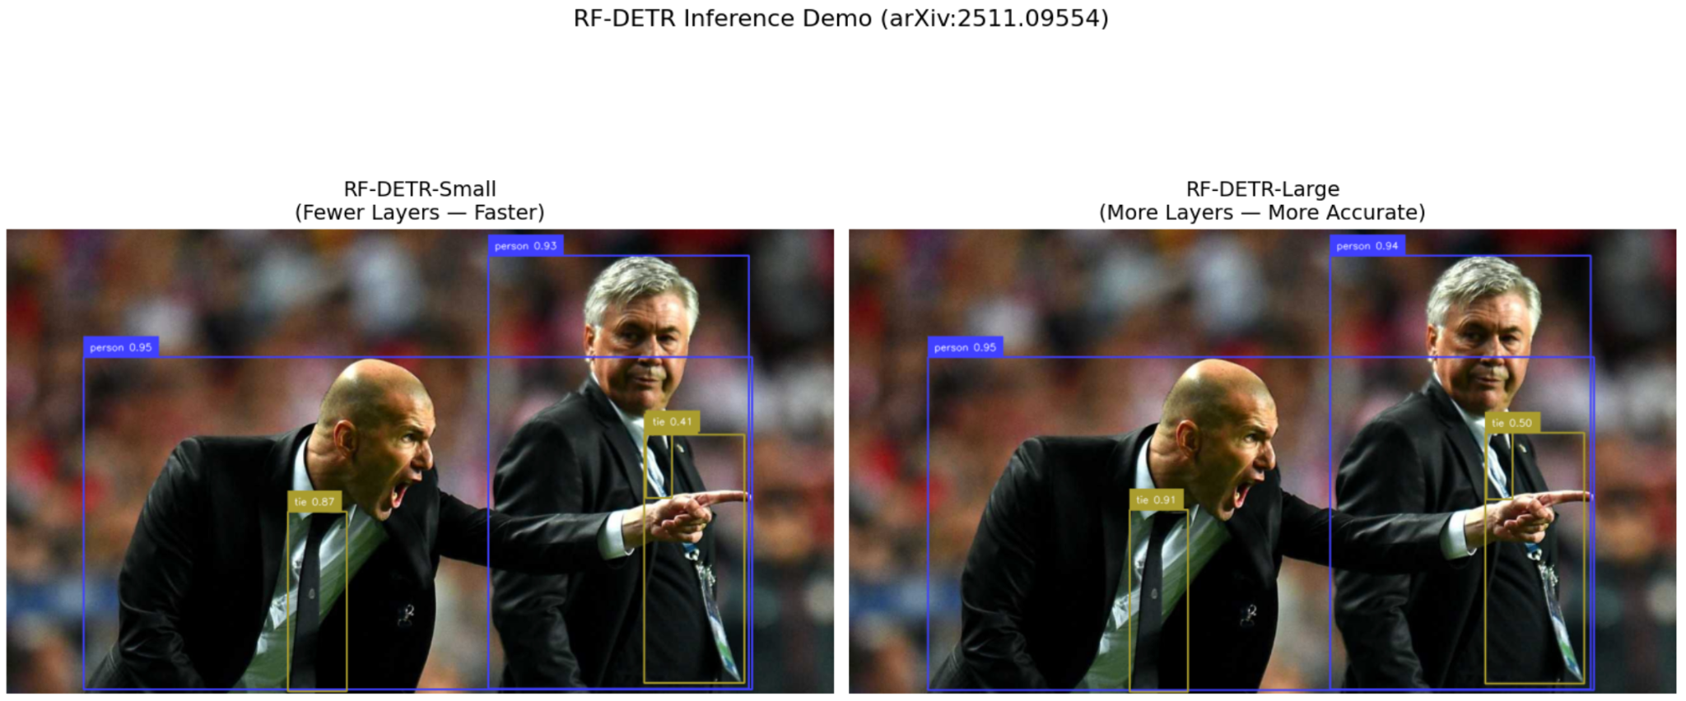
Lab Activity: Inference Demo
Small vs. Large Comparison
In Part 1 of the lab, we replicate the paper's results by testing different decoder depths:
•
RF-DETR-Small: 32.1M params. Optimized for speed, identifies primary subjects quickly.
•
RF-DETR-Large: 33.9M params. More accurate, detects more people at higher confidence levels.
Large model picks up crowded groups more effectively than Small/Base.

Slide 7

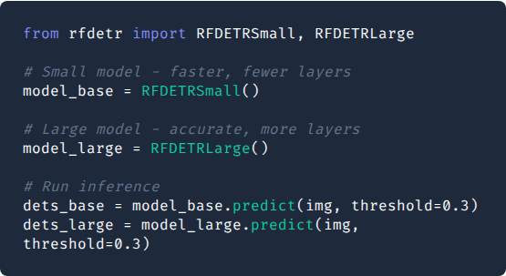
Lab Part 1: Model Initialization
Implementation Logic
We instantiate two distinct scales to demonstrate the trade-off. The Small model uses fewer decoder layers for speed, while the Large model leverages depth for precision.
The .predict() method handles the entire pipeline: image pre-processing, forward pass, and bounding-box decoding.

Slide 8
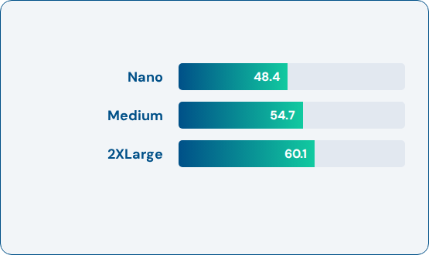
Lab Activity: COCO Benchmarking
Replicating SOTA Numbers
Part 2 involves evaluating the pre-trained family on MS COCO val2017:
Performance Benchmark
•
Utilizing pycocotools for standard metrics.
•
Hardware: NVIDIA T4 GPU (GCP/Colab).
•
Software: CUDA 12.4 + TensorRT 10.4.
MS COCO AP50:95 Values
•
Goal: Verify that accuracy and latency match reported author values.

Slide 9
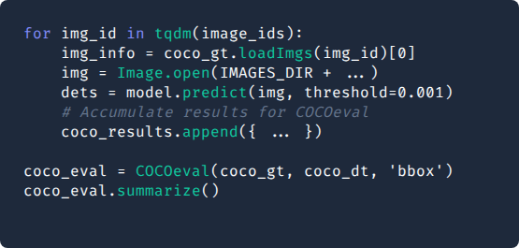
Lab Part 2: COCO Benchmarking
Validation Methodology
•
Threshold: Set to 0.001 to ensure all potential boxes are considered for mAP calculation.
•
COCOeval: Uses standard Intersection over Union (IoU) metrics to calculate precision and recall across multiple scales.
•
Latency: Measured using TensorRT FP16 on T4 GPUs to ensure real-time validity.

Slide 10
Performance Summary Table
Model Variant | COCO AP (50:95) | Latency (ms) | Params (M) | Resolution
RF-DETR-Nano | 48.4 | 2.3 | 30.5 | 384x384
RF-DETR-Small | 53.0 | 3.5 | 32.1 | 512x512
RF-DETR-Medium | 54.7 | 4.4 | 33.7 | 576x576
RF-DETR-Large | 56.5 | 6.8 | 33.9 | 704x704
RF-DETR-XLarge | 58.6 | 11.5 | 126.4 | 700x700
RF-DETR-2XL | 60.1 | 17.2 | 126.9 | 880x880
*Latency measured on NVIDIA T4 using TensorRT FP16, batch=1.

Slide 11
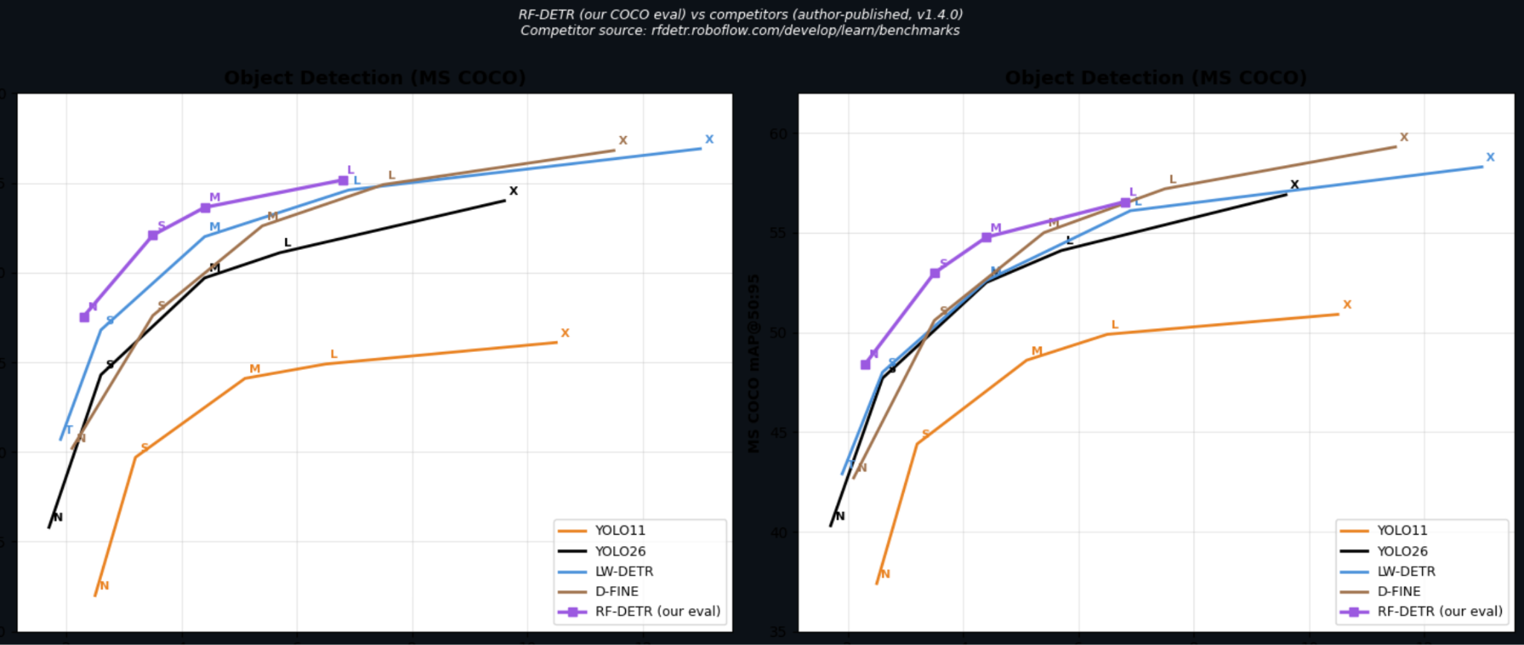
COCO Benchmark Evaluation

Slide 12
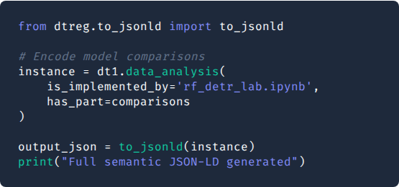
Lab Part 3: Knowledge Packaging
Machine-Readable Records
Using the dtreg package, we map our Python results to semantic objects. This prevents scientific findings from being "buried" in static PDFs.
The to_jsonld() function serializes our benchmarks into a graph that AI search engines can ingest directly.

Slide 13
TIB Knowledge Loom Integration
"Born Reusable" Research
The lab work concludes with semantic data extraction for the TIB Knowledge Loom:
Metadata: JSON-LD (RO-Crate) format.
Integration: Interlinking findings with the Open Research Knowledge Graph (ORKG).
Machine-Readable: Findings are encoded so AI systems can reuse them without manual extraction.

Slide 14
Questions?
Analysis of RF-DETR: Neural Architecture Search for Real-Time Detection Transformers
GitHub: roboflow/rf-detr
TIB Knowledge Loom: knowledgeloom.tib.eu

